Slide 1
Unit-1 Introduction to relational database & relational algebra

Slide 2
✓
Looping
Outline
Structure of Relational Databases
Key
Relational Algebra
Fundamental Operators and Syntax
Selection
Projection
Cross Product OR Cartesian Product
Joins
Set Operators
Division
Rename
Aggregate Functions
Open Source and Commercial DBMS

Slide 3
Structure of Relational Databases
Section - 1

Slide 4
Structure of Relational Databases
Columns (5)
Table (Relation): A database object that holds a collection of data for a specific topic.
Table consist of rows and columns.
Student
Attributes:
Title of column
RollNo | Name | Branch | Semester | SPI
101 | Raju | CE | 3 | 8
102 | Mitesh | CI | 3 | 7
103 | Mayur | CE | 3 | 6
104 | Nilesh | EE | 3 | 9
105 | Hitesh | CI | 3 | 7
106 | Tarun | ME | 3 | 8
107 | Suresh | CE | 3 | 9
Column (Attribute): The vertical component of a table. A column has a name and a particular data type; e.g. varchar, decimal, integer, datetime etc.
Rows or
Tuples or Records (7)
Record (Tuple): The horizontal component of a table, consisting of a sequence of values, one for each column of the table. It is also known as row.
Cardinality = No of tuples (7)
A database consists of a collection of tables (relations), each having a unique name.
Degree = No of columns (5)
Domain is a set of all possible unique values for a specific column.
Domain of Branch attribute is (CE, CI, ME, EE)

Slide 5
Key
Section - 2

Slide 6
Super Key
A super key is a set of one or more attributes whose values uniquely identifies each record within a relation (table).
Super Key
EnrollNo
Super Key
(RollNo, Branch, Sem)
Super Key
(SPI, Name, BL)
EnrollNo | RollNo | Branch | Sem | SPI | Name | BL
190540107001 | 101 | CE | 3 | 8 | Raju | 0
190540107002 | 102 | CE | 3 | 7 | Mitesh | 1
190540106001 | 101 | CI | 3 | 6 | Mayur | 2
190540106002 | 102 | CI | 3 | 9 | Nilesh | 0
180540107001 | 101 | CE | 5 | 7 | Hitesh | 1
180540106001 | 101 | CI | 5 | 8 | Tarun | 0
180540106002 | 102 | CI | 5 | 9 | Suresh | 0

Slide 7
Candidate Key
A candidate key is a subset of a super key.
A candidate key is a single attribute or the least combination of attributes that uniquely identifies each record in the table.
A candidate key is a super key for which no proper subset is a super key.
Every candidate key is a super key but every super key is not a candidate key.
Candidate Key
EnrollNo
Candidate Key
(RollNo, Branch, Sem)
EnrollNo | RollNo | Branch | Sem | SPI | Name | BL
190540107001 | 101 | CE | 3 | 8 | Raju | 0
180540107002 | 101 | CE | 5 | 7 | Mitesh | 1
190540106001 | 101 | CI | 3 | 6 | Mayur | 2
180540106002 | 101 | CI | 5 | 9 | Nilesh | 0

Slide 8

Primary Key
A primary key is a candidate key that is chosen by database designer to identify tuples uniquely in a relation (table).
Primary Key
Candidate Key
EnrollNo
Candidate Key
(RollNo, Branch, Sem)
EnrollNo | RollNo | Branch | Sem | SPI | Name | BL
190540107001 | 101 | CE | 3 | 8 | Raju | 0
180540107002 | 101 | CE | 5 | 7 | Mitesh | 1
190540106001 | 101 | CI | 3 | 6 | Mayur | 2
180540106002 | 101 | CI | 5 | 9 | Nilesh | 0

Slide 9
Alternate Key
An alternate key is a candidate key that is not chosen by database designer to identify tuples uniquely in a relation.
Primary Key
Alternate Key
Candidate Key
EnrollNo
Candidate Key
(RollNo, Branch, Sem)
EnrollNo | RollNo | Branch | Sem | SPI | Name | BL
190540107001 | 101 | CE | 3 | 8 | Raju | 0
180540107002 | 101 | CE | 5 | 7 | Mitesh | 1
190540106001 | 101 | CI | 3 | 6 | Mayur | 2
180540106002 | 101 | CI | 5 | 9 | Nilesh | 0

Slide 10
Primary Key rules
A primary key may have one or more attributes.
There is only one primary key in the relation (table).
A primary key attribute value cannot be NULL.
Generally, the value of a primary key attribute does not change.

Slide 11
Foreign Key
A foreign key is used to link two relations (tables).
A foreign key is an attribute or collection of attributes in one table that refers to the primary key in another table.
A table containing the foreign key is called the child table, and the table containing the primary key is called the parent table.
Parent
Table
Child
Table
Student
Project
EnrollNo | Name | Branch | Sem
190540107001 | Raju | CE | 3
190540107002 | Mitesh | CE | 3
190540107003 | Nilesh | CE | 3
190540107004 | Meet | CE | 3
ProjectID | Title | EnrollNo
101 | Bank | 190540107001
102 | College | 190540107002
103 | School | 190540107003
104 | Hospital | 190540107001

Slide 12
Relational Algebra Operations
Section - 3

Slide 13
Relational Algebra Operations
Operator | Description
Selection | Display particular rows/records/tuples from a relation
Projection | Display particular columns from a relation
Cross Product | Multiply each tuples of both relations
Joins | Combine data or records from two or more tables Natural Join / Inner Join Outer Join 1. Left Outer Join 2. Right Outer Join 3. Full Outer Join
Set Operators | Combine the results of two queries into a single result. 1. Union 2. Intersection 3. Minus / Set-difference
Division | Divides one relation by another
Rename | Rename a column or a table

Slide 14
Relational Algebra Operations Selection Operator
Section - 3.1

Slide 15
Selection Operator
Symbol: σ (Sigma)
Notation: σ _{condition} (Relation)
Operation: Selects tuples from a relation that satisfy a given condition.
Operators: =, <>, <, >, <=, >=, Λ (AND), V (OR)
σ_{Branch=‘CE’} (Student)
Display the detail of students belongs to “CE” Branch.
Answer
Example
Student
Output
RollNo | Name | Branch | SPI
101 | Raju | CE | 8
102 | Mitesh | ME | 9
103 | Nilesh | CI | 9
104 | Meet | CE | 9
RollNo | Name | Branch | SPI
101 | Raju | CE | 8
104 | Meet | CE | 9

Slide 16
Selection Operator [σ _{condition} (Relation)]
Display the detail of students belongs to “CE” Branch and having SPI more than 8.
Example
Student
RollNo | Name | Branch | SPI
101 | Raju | CE | 8
102 | Mitesh | ME | 9
103 | Nilesh | CI | 9
104 | Meet | CE | 9
σ_{Branch=‘CE’ Λ SPI>8} (Student)
Answer
Output
RollNo | Name | Branch | SPI
104 | Meet | CE | 9

Slide 17
Selection Operator [σ _{condition} (Relation)]
Display the detail of students belongs to either “CI” or “ME” Branch.
Example
Student
RollNo | Name | Branch | SPI
101 | Raju | CE | 8
102 | Mitesh | ME | 9
103 | Nilesh | CI | 9
104 | Meet | CE | 9
σ_{Branch=‘CI’ V Branch=‘ME’} (Student)
Answer
Output
RollNo | Name | Branch | SPI
102 | Mitesh | ME | 9
103 | Nilesh | CI | 9

Slide 18
Selection Operator [σ _{condition} (Relation)]
Display the detail of students whose SPI between 7 and 9.
Example
Student
RollNo | Name | Branch | SPI
101 | Raju | CE | 8
102 | Mitesh | ME | 9
103 | Nilesh | CI | 9
104 | Meet | CE | 9
σ_{SPI>7 Λ SPI<9} (Student)
Answer
Output
RollNo | Name | Branch | SPI
101 | Raju | CE | 8

Slide 19
Exercise
Write down the relational algebra for the student table.
Display the detail of students whose RollNo is less than 104.
Display the detail of students having SPI more than 8.
Display the detail of students belongs to “CE” Branch having SPI less than 8.
Display the detail of students belongs to either “CE” or “ME” Branch.
Display the detail of students whose SPI between 6 and 9.
Student
RollNo | Name | Branch | SPI
101 | Raj | CE | 6
102 | Meet | ME | 8
103 | Harsh | EE | 7
104 | Punit | CE | 9
Write down the relational algebra for the employee table.
Display the detail of all employee.
Display the detail of employee whose Salary more than 10000.
Display the detail of employee belongs to “HR” Dept having Salary more than 20000.
Display the detail of employee belongs to either “HR” or “Admin” Dept.
Display the detail of employee whose Salary between 10000 and 25000 and belongs to “HR” Dept.
Employee
EmpID | Name | Dept | Salary
101 | Nilesh | Sales | 10000
102 | Mayur | HR | 25000
103 | Hardik | HR | 15000
104 | Ajay | Admin | 20000

Slide 20
Relational Algebra Operations Projection Operator
Section - 3.2

Slide 21
Projection Operator
Symbol: ∏ (Pi)
Notation: ∏ _{attribute set} (Relation)
Operation: Selects specified attributes of a relation.
It removes duplicate tuples (records) from the result.
∏ _{RollNo, Name, Branch} (Student)
Display RollNo, Name and Branch of all students.
Answer
Example
Student
Output
RollNo | Name | Branch | SPI
101 | Raju | CE | 8
102 | Mitesh | ME | 9
103 | Nilesh | CI | 9
104 | Meet | CE | 9
RollNo | Name | Branch
101 | Raju | CE
102 | Mitesh | ME
103 | Nilesh | CI
104 | Meet | CE

Slide 22
Exercise
Write down the relational algebra for the student table.
Display RollNo, Name and SPI of all students.
Display Name and SPI of all students.
Display the Name of all students.
Display the Name of all branches.
Student
RollNo | Name | Branch | SPI
101 | Raj | CE | 6
102 | Meet | ME | 8
103 | Harsh | EE | 7
104 | Punit | CE | 9
Write down the relational algebra for the employee table.
Display EmpID with Name of all employee.
Display Name and Salary of all employee.
Display the Name of all employee.
Display the Name of all departments.
Employee
EmpID | Name | Dept | Salary
101 | Nilesh | Sales | 10000
102 | Mayur | HR | 25000
103 | Hardik | HR | 15000
104 | Ajay | Admin | 20000

Slide 23
Combined Projection & Selection Operation
Display RollNo, Name & Branch of “ME” Branch students.
Example
Student
RollNo | Name | Branch | SPI
101 | Raju | CE | 8
102 | Mitesh | ME | 9
103 | Nilesh | CI | 9
104 | Meet | CE | 7
σ_{Branch=‘ME’} (Student)
∏ _{RollNo, Name, Branch} (σ_{Branch=‘ME’} (Student))
Step-1
Answer
Output-1
Output-2
RollNo | Name | Branch | SPI
102 | Mitesh | ME | 9
RollNo | Name | Branch
102 | Mitesh | ME

Slide 24
Combined Projection & Selection Operation
Display Name, Branch and SPI of students whose SPI is more than 8.
Example
Student
RollNo | Name | Branch | SPI
101 | Raju | CE | 8
102 | Mitesh | ME | 9
103 | Nilesh | CI | 9
104 | Meet | CE | 7
σ_{SPI>8} (Student)
∏ _{Name, Branch, SPI} (σ_{SPI>8} (Student))
Step-1
Answer
Output-1
Output-2
RollNo | Name | Branch | SPI
102 | Mitesh | ME | 9
103 | Nilesh | CI | 9
Name | Branch | SPI
Mitesh | ME | 9
Nilesh | CI | 9

Slide 25
Combined Projection & Selection Operation
Display Name, Branch and SPI of students who belongs to “CE” Branch and SPI is more than 7.
Example
Student
RollNo | Name | Branch | SPI
101 | Raju | CE | 8
102 | Mitesh | ME | 9
103 | Nilesh | CI | 9
104 | Meet | CE | 7
σ_{Branch=‘CE’ Λ SPI>7} (Student)
∏ _{Name, Branch, SPI} (σ_{Branch=‘CE’ Λ SPI>7} (Student))
Step-1
Answer
Output-1
Output-2
RollNo | Name | Branch | SPI
101 | Raju | CE | 8
Name | Branch | SPI
Raju | CE | 8

Slide 26
Combined Projection & Selection Operation
Display Name of students along with their Branch who belong to either “ME” Branch or “CI” Branch.
Example
Student
RollNo | Name | Branch | SPI
101 | Raju | CE | 8
102 | Mitesh | ME | 9
103 | Nilesh | CI | 9
104 | Meet | CE | 7
σ_{Branch=‘ME’ V Branch=‘CI’} (Student)
∏ _{Name, Branch} (σ_{Branch=‘ME’ V Branch=‘CI’} (Student))
Step-1
Answer
Output-1
Output-2
RollNo | Name | Branch | SPI
102 | Mitesh | ME | 9
103 | Nilesh | CI | 9
Name | Branch
Mitesh | ME
Nilesh | CI

Slide 27
Exercise
Write down the relational algebra for the student table.
Display Rollno, Name and SPI of all students belongs to “CE” Branch.
List the Name of students with their Branch whose SPI is more than 8 and belongs to “CE” Branch.
List the Name of students along with their Branch and SPI who belongs to either “CE” or “ME” Branch and having SPI more than 8.
Display the Name of students with their Branch name whose SPI between 7 and 9.
Student
RollNo | Name | Branch | SPI
101 | Raj | CE | 6
102 | Meet | ME | 8
103 | Harsh | EE | 7
104 | Punit | CE | 9
Write down the relational algebra for the employee table.
Display the Name of employee belong to “HR” Dept and having salary more than 20000.
Display the Name of all “Admin” and “HR” Dept’s employee.
List the Name of employee with their Salary who belongs to “HR” or “Admin” Dept having salary more than 15000.
Display the Name of employee along with their Dept name whose salary between 15000 and 30000.
Employee
EmpID | Name | Dept | Salary
101 | Nilesh | Sales | 10000
102 | Mayur | HR | 25000
103 | Hardik | HR | 15000
104 | Ajay | Admin | 20000

Slide 28
Relational Algebra Operations Cartesian Product / Cross Product
Section - 3.3

Slide 29
Cartesian Product / Cross Product
Symbol: X (Cross)
Notation: Relation-1 (R1) X Relation-2 (R2) OR Algebra-1 X Algebra-2
Operation: It will multiply each tuples of Relation-1 to each tuples of Relation-2.
Attributes of Resultant Relation = Attributes of R1 + Attributes of R2
Tuples of Resultant Relation = Tuples of R1 * Tuples of R2
Perform Cross Product between Student and Result.
(Student) X (Result)
Example
Answer
Student
Result
Output
RNo | Name | Branch
101 | Raju | CE
102 | Mitesh | ME
RNo | SPI
101 | 8
102 | 9
Student.RNo | Name | Branch | Result.RNo | SPI
101 | Raju | CE | 101 | 8
101 | Raju | CE | 102 | 9
102 | Mitesh | ME | 101 | 8
102 | Mitesh | ME | 102 | 9
If both relations have some attribute with the same name, it can be distinguished by combing relation-name.attribute-name.

Slide 30
Cartesian Product / Cross Product Example
Perform Cross Product between Student and Result.
Consider only selected attributes
Student – RNo, Name and Branch
Result – RNo, SPI and BL
Example
Student
Result
RNo | Name | Branch | Sem
101 | Raju | CE | 3
102 | Mitesh | ME | 5
RNo | SPI | BL | Rank
101 | 8 | 1 | 2
103 | 9 | 0 | 1
∏ _{RNo, Name, Branch} (Student) X ∏ _{RNo, SPI, BL} (Result)
Answer
Output
Student.RNo | Name | Branch | Result.RNo | SPI | BL
101 | Raju | CE | 101 | 8 | 1
101 | Raju | CE | 103 | 9 | 0
102 | Mitesh | ME | 101 | 8 | 1
102 | Mitesh | ME | 103 | 9 | 0

Slide 31
Cartesian Product / Cross Product Example
Perform Cross Product between Student and Result.
Consider only selected tuples
Student – Branch=‘CE’ and Sem=3
Result – SPI>7 and BL<1
Example
Student
Result
RNo | Name | Branch | Sem
101 | Raju | CE | 3
102 | Mitesh | ME | 5
103 | Om | CE | 3
104 | Dhara | CE | 5
RNo | SPI | BL | Rank
101 | 8 | 1 | 2
103 | 9 | 0 | 1
105 | 7 | 2 | 3
σ_{Branch=‘CE’ Λ Sem=3} (Student) X σ_{SPI>7 Λ BL<1} (Result)
Answer
Output
Student.RNo | Name | Branch | Sem | Result.RNo | SPI | BL | Rank
101 | Raju | CE | 3 | 103 | 9 | 0 | 1
103 | OM | CE | 3 | 103 | 9 | 0 | 1

Slide 32
Relational Algebra Operations Natural Join / Inner Join
Section - 3.4

Slide 33
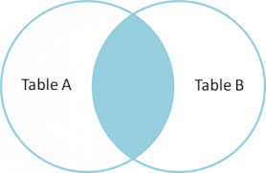
Natural Join / Inner Join
Symbol:
Notation: Relation-1 (R1) Relation-2 (R2) OR Algebra-1 Algebra-2
Operation: Natural join will retrieve consistent data from multiple relations.
It combines records from different relations that satisfy a given condition.
Steps performed in Natural Join
Steps | Description
Step – 1 | It performs Cartesian Product
Step – 2 | Then it deletes inconsistent tuples
Step – 3 | Then it removes an attribute from duplicate attributes

Slide 34
Natural Join / Inner Join Example
Perform Natural Join between Student and Result.
(Student) (Result)
Example
Answer
Student
Result
Output
RNo | Name | Branch
101 | Raju | CE
102 | Mitesh | ME
RNo | SPI
101 | 8
103 | 9
RNo | Name | Branch | SPI
101 | Raju | CE | 8
To perform a Natural Join there must be one common attribute (column) between two relations.
Steps performed in Natural Join
Step:1 Perform Cross Product
Step:2 Removes inconsistent tuples
Student.RNo | Name | Branch | Result.RNo | SPI
101 | Raju | CE | 101 | 8
101 | Raju | CE | 103 | 9
102 | Mitesh | ME | 101 | 8
102 | Mitesh | ME | 103 | 9
Student.RNo | Name | Branch | Result.RNo | SPI
101 | Raju | CE | 101 | 8
Step:3 Removes an attribute from duplicate
RNo | Name | Branch | SPI
101 | Raju | CE | 8

Slide 35
Natural Join / Inner Join Example
Perform Natural Join between Branch and Faculty.
(Branch) (Faculty)
Example
Answer
Branch
Faculty
Output
BID | BName | HOD
1 | CE | Shah
2 | ME | Patel
FID | FName | BID
101 | Raj | 1
103 | Meet | 2
BID | Bname | HOD | FID | FName
1 | CE | Shah | 101 | Raj
2 | ME | Patel | 103 | Meet
To perform a Natural Join there must be one common attribute (column) between two relations.

Slide 36
Write down relational algebra for the following tables/relations
Relations
Student (Rno, Sname, Address, City, Mobile)
Department (Did, Dname)
Academic (Rno, Did, SPI, CPI, Backlog)
Guide (Rno, PName, Fid)
Faculty (Fid, Fname, Subject, Did, Salary)
List the name of students with their department name and SPI of all student belong to “CE” department.
Example
∏ _{Sname, Dname, SPI}
(σ_{Dname=‘CE’} (Student (Department Academic)))
Answer
Display the name of students with their project name whose guide is “A. J. Shah”.
Example
(σ_{Fname=‘A.J.Shah’} (Student (Guide Faculty)))
∏ _{Sname, Pname}
Answer

Slide 37
Exercise: Write down relational algebra for the following tables/relations
Relations
Student (Rno, Sname, Address, City, Mobile)
Department (Did, Dname)
Academic (Rno, Did, SPI, CPI, Backlog)
Guide (Rno, PName, Fid)
Faculty (Fid, Fname, Subject, Did, Salary)
List the name of students with their department name having backlog 0.
List the name of faculties with their department name and salary having salary more than 25000 and belongs to “CE” department.
List the name of all faculties of “CE” and “ME” department whose salary is more than 50000.
Display the students name with their project name of all “CE” department’s students whose guide is “Z.Z. Patel”.
Display the name of faculties with their department name who belongs to “CE” department and tough “CPU” subject having salary more than 25000.
List the name of students with their department name doing project “Hackathon” under guide “I. I. Shah”.

Slide 38
Relational Algebra Operations Outer Join
Section - 3.5

Slide 39
Outer Join
In natural join some records are missing, if we want that missing records than we have to use outer join.
Three types of Outer Join
Sr. | Outer Join | Symbol
1 | Left Outer Join
2 | Right Outer Join
3 | Full Outer Join
To perform a Outer Join there must be one common attribute (column) between two relations.

Slide 40
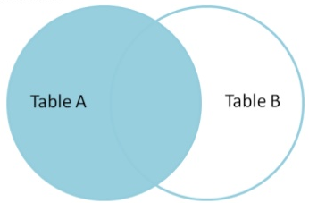
Left Outer Join
Symbol:
Notation: Relation-1 (R1) Relation-2 (R2) OR Algebra-1 Algebra-2
Operation:
Display all the tuples of the left relation even through there is no matching tuple in the right relation.
For such kind of tuples having no matching, the attributes of right relation will be padded with NULL in resultant relation.
Perform Left Outer Join between Student and Result.
(Student) (Result)
Example
Answer
Student
Result
Output
RollNo | Name | Branch
101 | Raj | CE
102 | Meet | ME
RollNo | SPI
101 | 8
103 | 9
RollNo | Name | Branch | SPI
101 | Raj | CE | 8
102 | Meet | ME | NULL
What is the output of (Result) (Student).
Exercise

Slide 41
Left Outer Join Example
Perform Left Outer Join between Student and Result. (Display RollNo, Name and SPI)
Example
Student
Result
RollNo | Name | Branch
101 | Raj | CE
102 | Meet | ME
RollNo | SPI | BL
101 | 8 | 1
103 | 9 | 0
∏ _{RollNo, Name, SPI}
((Student) (Result))
Answer
Output
RollNo | Name | SPI
101 | Raj | 8
102 | Meet | NULL

Slide 42
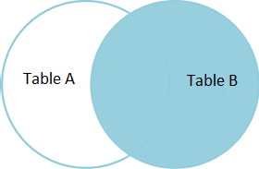
Right Outer Join
Symbol:
Notation: Relation-1 (R1) Relation-2 (R2) OR Algebra-1 Algebra-2
Operation:
Display all the tuples of right relation even through there is no matching tuple in the left relation.
For such kind of tuples having no matching, the attributes of left relation will be padded with NULL in resultant relation.
Perform Right Outer Join between Student and Result.
(Student) (Result)
Example
Answer
Student
Result
Output
RollNo | Name | Branch
101 | Raj | CE
102 | Meet | ME
RollNo | SPI
101 | 8
103 | 9
RollNo | Name | Branch | SPI
101 | Raj | CE | 8
103 | NULL | NULL | 9
What is the output of (Result) (Student).
Exercise

Slide 43
Right Outer Join Example
Perform Right Outer Join between Student and Result. (Display RollNo, Name and SPI)
Example
Student
Result
RollNo | Name | Branch
101 | Raj | CE
102 | Meet | ME
RollNo | SPI | BL
101 | 8 | 1
103 | 9 | 0
∏ _{RollNo, Name, SPI}
((Student) (Result))
Answer
Output
RollNo | Name | SPI
101 | Raj | 8
103 | NULL | 9

Slide 44
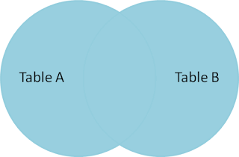
Full Outer Join
Symbol:
Notation: Relation-1 (R1) Relation-2 (R2) OR Algebra-1 Algebra-2
Operation:
Display all the tuples of both of the relations. It also pads null values whenever required. (Left outer join + Right outer join)
For such kind of tuples having no matching, it will be padded with NULL in resultant relation.
Perform Full Outer Join between Student and Result.
(Student) (Result)
Example
Answer
Student
Result
Output
RollNo | Name | Branch
101 | Raj | CE
102 | Meet | ME
RollNo | SPI
101 | 8
103 | 9
RollNo | Name | Branch | SPI
101 | Raj | CE | 8
102 | Meet | ME | NULL
103 | NULL | NULL | 9
What is the output of (Result) (Student).
Exercise

Slide 45
Full Outer Join Example
Perform Full Outer Join between Student and Result. (Display RollNo, Name and SPI)
Example
Student
Result
RollNo | Name | Branch
101 | Raj | CE
102 | Meet | ME
RollNo | SPI | BL
101 | 8 | 1
103 | 9 | 0
∏ _{RollNo, Name, SPI}
((Student) (Result))
Answer
Output
RollNo | Name | SPI
101 | Raj | 8
102 | Meet | NULL
103 | NULL | 9

Slide 46
Relational Algebra Operations Set Operators
Section - 3.6

Slide 47
Set Operators
Set operators combine the results of two or more queries into a single result.
Three types of Set Operators
Sr. | Set Operator | Symbol
1 | Union | U
2 | Intersect / Intersection | ∩
3 | Minus / Set difference | −
Set operators will take two or more queries as input, which must be union-compatible.
Conditions
Both queries should have same (equal) number of columns
Corresponding attributes should have the same data type or domain

Slide 48

Conditions to perform Set Operators
Conditions-1
Both queries should have same (equal) number of columns.
Student
Faculty
Student
Faculty
RNo | Name | Dept | SPI
101 | Raj | CE | 8
102 | Meet | ME | 9
103 | Jay | CE | 9
FId | Name | Dept
101 | Patel | CE
102 | Shah | ME
103 | Dave | ME
RNo | Name | Dept
101 | Raj | CE
102 | Meet | ME
103 | Jay | CE
FId | Name | Dept
101 | Patel | CE
102 | Shah | ME
103 | Dave | ME
Conditions-2
Corresponding attributes should have the same data type.
Student
Faculty
Student
Faculty
RNo | Name | Dept | SPI
101 | Raj | CE | 8
102 | Meet | ME | 9
103 | Jay | CE | 9
FId | Name | Dept | Sub
101 | Patel | CE | DS
102 | Shah | ME | DBMS
103 | Dave | ME | DF
RNo | Name | Dept | SPI
101 | Raj | CE | 8
102 | Meet | ME | 9
103 | Jay | CE | 9
FId | Name | Dept | Exp
101 | Patel | CE | 5
102 | Shah | ME | 3
103 | Dave | ME | 4

Slide 49
Set Operators [Exercise]
Check whether following tables are compatible or not:
Exercise
A: (First_name(char), Last_name(char), Date_of_Birth(date))
B: (FName(char), LName(char), PhoneNumber(number))
(Not compatible) Both tables have 3 attributes but third attributes datatype is different.
A: (First_name(char), Last_name(char), Date_of_Birth(date))
B: (FName(char), LName(char), DOB(date))
(Compatible) Both tables have 3 attributes and of same data type.
Person (PersonID, Name, Address, Hobby)
Professor (ProfessorID, Name, OfficeAddress, Salary)
(Not compatible) Both tables have 4 attributes but forth attributes datatype is different.
(Compatible) Both tables have 2 attributes and of same data type.
∏ _{Name, Address} (Person)
∏ _{Name, OfficeAddress} (Professor)
&

Slide 50
Union Operator
Symbol: U
Notation: Relation-1 (R1) U Relation-2 (R2) OR Algebra-1 U Algebra-2
Operation:
It displays all the tuples/records belonging to the first relation (left relation) or the second relation (right relation) or both.
It also eliminates duplicate tuples (tuples present in both relations appear once).
Perform Union between Customer and Employee.
(Customer) U (Employee)
Example
Answer
Customer
Employee
Output
Name
Raju
Suresh
Meet
Name
Meet
Suresh
Manoj
Name
Manoj
Meet
Raju
Suresh
Is there any difference in the output if we swap the tables in Union operator. (Employee) U (Customer).
Exercise

Slide 51
Intersect/ Intersection Operator
Symbol: ∩
Notation: Relation-1 (R1) ∩ Relation-2 (R2) OR Algebra-1 ∩ Algebra-2
Operation:
It displays all the tuples/records belonging to both relations. OR
It displays all the tuples/records which are common from both relations.
Perform Intersection between Customer and Employee.
(Customer) ∩ (Employee)
Example
Answer
Customer
Employee
Output
Name
Raju
Suresh
Meet
Name
Meet
Suresh
Manoj
Name
Meet
Suresh
Is there any difference in the output if we swap the tables in Intersection. (Employee) ∩ (Customer).
Exercise

Slide 52
Minus/ Set difference Operator
Symbol: −
Notation: Relation-1 (R1) − Relation-2 (R2) OR Algebra-1 − Algebra-2
Operation:
It displays all the tuples/records belonging to the first relation (left relation) but not in the second relation (right relation).
Perform Set difference between Customer and Employee.
(Customer) − (Employee)
Example
Answer
Customer
Employee
Output
Name
Raju
Suresh
Meet
Name
Meet
Suresh
Manoj
Name
Raju
Is there any difference in the output if we swap the tables in Set difference. (Employee) − (Customer).
Exercise

Slide 53
Union Operators Example
Display Name of person who are either employee or customer.
Example
Customer
Employee
ID | Name | Balance
1 | Raju | 10000
2 | Suresh | 20000
ID | Name | Dept | Salary
2 | Suresh | CE | 8000
3 | Manoj | ME | 9000
∏ _{Name} (Customer) U ∏ _{Name} (Employee)
Answer
Output
Name
Manoj
Raju
Suresh

Slide 54
Intersect/ Intersection Operators Example
Display Name of person who are employee as well as customer.
Example
Customer
Employee
ID | Name | Balance
1 | Raju | 10000
2 | Suresh | 20000
ID | Name | Dept | Salary
2 | Suresh | CE | 8000
3 | Manoj | ME | 9000
∏ _{Name} (Customer) ∩ ∏ _{Name} (Employee)
Answer
Output
Name
Suresh

Slide 55
Minus/ Set difference Operators Example
Display Name of person who are employee but not customer.
Example
Customer
Employee
ID | Name | Balance
1 | Raju | 10000
2 | Suresh | 20000
ID | Name | Dept | Salary
2 | Suresh | CE | 8000
3 | Manoj | ME | 9000
∏ _{Name} (Employee) − ∏ _{Name} (Customer)
Answer
Output
Name
Manoj

Slide 56
Minus/ Set difference Operators Example
Display Name of person who are customer but not employee.
Example
Customer
Employee
ID | Name | Balance
1 | Raju | 10000
2 | Suresh | 20000
ID | Name | Dept | Salary
2 | Suresh | CE | 8000
3 | Manoj | ME | 9000
∏ _{Name} (Customer) − ∏ _{Name} (Employee)
Answer
Output
Name
Raju

Slide 57
Set Operators [Exercise]
What is the output of following relational algebra for the below mentioned tables:
Exercise
Customer
Employee
ID | Name | Balance
1 | Raju | 10000
2 | Suresh | 20000
ID | Name | Dept | Salary
2 | Suresh | CE | 8000
3 | Manoj | ME | 9000
∏ _{ID, Name} (Customer) U ∏ _{ID, Name} (Employee)
Algebra-1
∏ _{ID, Name, Balance} (Customer) U ∏ _{ID, Name, Salary} (Employee)
Algebra-2
∏ _{ID, Name} (Customer) ∩ ∏ _{ID, Name} (Employee)
Algebra-3
∏ _{ID, Name, Balance} (Customer) ∩ ∏ _{ID, Name, Salary} (Employee)
Algebra-4

Slide 58
Set Operators [Exercise]
What is the output of following relational algebra for the below mentioned tables:
Exercise
Customer
Employee
ID | Name | Balance
1 | Raju | 10000
2 | Suresh | 20000
ID | Name | Dept | Salary
2 | Suresh | CE | 8000
3 | Manoj | ME | 9000
∏ _{ID, Name} (Customer) − ∏ _{ID, Name} (Employee)
Algebra-1
∏ _{ID, Name, Balance} (Customer) − ∏ _{ID, Name, Salary} (Employee)
Algebra-2
∏ _{ID, Name} (Employee) − ∏ _{ID, Name} (Customer)
Algebra-3
∏ _{ID, Name, Balance} (Employee) − ∏ _{ID, Name, Salary} (Customer)
Algebra-4

Slide 59
Relational Algebra Operations Division Operator
Section - 3.7

Slide 60
Division Operator
Symbol: ÷ (Division)
Notation: Relation1 (R1) ÷ Relation2 (R2) OR Algebra1 ÷ Algebra2
Condition:
Attributes of relation2/algebra2 must be a proper subset of attributes of relation1/algebra1.
Operation:
The output of the division operator will have attributes =
All attributes of relation1 – All attributes of relation2
The output of the division operator will have tuples =
Tuples in relation1, which are associated with the all tuples of relation2.

Slide 61
Division Operator Example
Perform Division operation between Student and Subject.
(Student) ÷ (Subject)
Example
Answer
Student
Subject
Output
Name | Subject
Raj | DBMS
Raj | DS
Meet | DS
Meet | DF
Rohit | DBMS
Rohit | DS
Rohit | DF
Suresh | DBMS
Suresh | DF
Suresh | DS
Subject
DBMS
DS
DF
Name
Rohit
Suresh

Slide 62
Division Operator Example
A
B1
B2
B3
B4
Sno | PNo
S1 | P1
S1 | P2
S1 | P3
S1 | P4
S2 | P1
S2 | P2
S3 | P2
S4 | P2
S4 | P4
S5 | P4
PNo
P2
PNo
P2
P4
PNo
P1
P2
P4
PNo
P2
P5
(A) ÷ (B1)
(A) ÷ (B2)
(A) ÷ (B3)
(A) ÷ (B4)
Algebra
Algebra
Algebra
Algebra
Output
Output
Output
Output
SNo
S1
S2
S3
S4
SNo
S1
S4
SNo
S1
SNo

Slide 63
Division Operator Example
List the name of students doing a project in all technologies.
Example
Student
Project
RNo | Name | Technology
101 | Raj | .NET
101 | Raj | PHP
102 | Meet | .NET
102 | Meet | PHP
102 | Meet | iPhone
102 | Meet | Android
103 | Rohit | Android
104 | Suresh | .NET
104 | Suresh | iPhone
104 | Suresh | Android
TID | Technology
1 | .NET
2 | PHP
3 | Android
4 | iPhone
∏ _{Name, Technology} (Student) ÷ ∏ _{Technology} (Project)
Answer
Output
Name
Meet

Slide 64
Relational Algebra Operations Rename Operator
Section - 3.8

Slide 65
Rename Operator
Symbol: ρ (Rho)
Notation: ρ_{A (X1,X2….Xn)} (Relation)
Operation:
The rename operation is used to rename the output relation.
The result of rename operator are also relations with new name.
The original relation name can not be changed when we perform rename operation on any relation.
How to use:
ρ _{x} (E)
Returns a relation E under a new name X.
ρ _{A1, A2. …,An} (E)
Returns a relation E with the attributes renamed to A1, A2, …., An.
ρ _{x(A1, A2. …,An)} (E)
Returns a relation E under a new name X with the attributes renamed to A1, A2, …., An.

Slide 66
Rename Operator Example
Rename table
Rename attributes
Example
Example
Student
Student
RNo | Name | CPI
101 | Raj | 8
102 | Meet | 9
103 | Jay | 7
Rno | Name | CPI
101 | Raj | 8
102 | Meet | 9
103 | Jay | 7
ρ_{Person} (Student)
ρ_{(RollNo, StudentName, SPI)} (Student)
Algebra
Algebra
Person
Student
RNo | Name | CPI
101 | Raj | 8
102 | Meet | 9
103 | Jay | 7
RollNo | StudentName | SPI
101 | Raj | 8
102 | Meet | 9
103 | Jay | 7

Slide 67
Rename Operator Example
Rename table and attributes both
Rename particular attributes
Example
Example
Student
Student
Rno | Name | CPI
101 | Raj | 8
102 | Meet | 9
103 | Jay | 7
Rno | Name | CPI
101 | Raj | 8
102 | Meet | 9
103 | Jay | 7
ρ_{Person (RollNo, StudentName)} (∏ _{RNo, Name} (Student))
ρ_{StudentName / Name} (Student)
Algebra
Algebra
Person
Student
RollNo | StudentName
101 | Raj
102 | Meet
103 | Jay
Rno | StudentName | CPI
101 | Raj | 8
102 | Meet | 9
103 | Jay | 7

Slide 68
Rename Operator Example
Find out maximum CPI from student table.
ρ_{A} (Student) X ρ_{B} (Student)
Example
Step-1
Student
Output-1
Rno | Name | CPI
101 | Raj | 8
102 | Meet | 9
103 | Jay | 7
A.Rno | A.Name | A.CPI | B.Rno | B.Name | B.CPI
101 | Raj | 8 | 101 | Raj | 8
101 | Raj | 8 | 102 | Meet | 9
101 | Raj | 8 | 103 | Jay | 7
102 | Meet | 9 | 101 | Raj | 8
102 | Meet | 9 | 102 | Meet | 9
102 | Meet | 9 | 103 | Jay | 7
103 | Jay | 7 | 101 | Raj | 8
103 | Jay | 7 | 102 | Meet | 9
103 | Jay | 7 | 103 | Jay | 7
σ_{A.CPI<B.CPI} (ρ_{A} (Student) X ρ_{B} (Student))
Step-2
Output-2
A.Rno | A.Name | A.CPI | B.Rno | B.Name | B.CPI
101 | Raj | 8 | 102 | Meet | 9
103 | Jay | 7 | 101 | Raj | 8
103 | Jay | 7 | 102 | Meet | 9

Slide 69
Rename Operator Example
Find out maximum CPI from student table.
Example
Student
∏ _{A.CPI} (σ_{A.CPI<B.CPI} (ρ_{A} (Student) X ρ_{B} (Student)))
Step-3
Rno | Name | CPI
101 | Raj | 8
102 | Meet | 9
103 | Jay | 7
Output-3
A.CPI
8
7
σ_{A.CPI<B.CPI} (ρ_{A} (Student) X ρ_{B} (Student))
Step-2
Output-2
A.Rno | A.Name | A.CPI | B.Rno | B.Name | B.CPI
101 | Raj | 8 | 102 | Meet | 9
103 | Jay | 7 | 101 | Raj | 8
103 | Jay | 7 | 102 | Meet | 9

Slide 70
Rename Operator Example
Find out maximum CPI from student table.
Example
Student
∏ _{A.CPI} (σ_{A.CPI<B.CPI} (ρ_{A} (Student) X ρ_{B} (Student)))
Step-3
Rno | Name | CPI
101 | Raj | 8
102 | Meet | 9
103 | Jay | 7
Output-3
A.CPI
8
7
∏ _{CPI} (Student) − ∏ _{A.CPI} (σ_{A.CPI<B.CPI} (ρ_{A} (Student) X ρ_{B} (Student)))
Step-4
Student
Output-3
Output
CPI
8
9
7
A.CPI
8
7
CPI
9
−
=

Slide 71
Relational Algebra Operations Aggregate Functions
Section - 3.9

Slide 72
Aggregate Functions
Symbol: g or G
Notation: g function-name(column), function-name(column), …, function-name(column) (Relation)
Operation:
It takes a more than one value as input and returns a single value as output (result).
Aggregate functions are:
Sum (It returns the sum (addition) of the values of a column.)
Max (It returns the maximum value for a column.)
Min (It returns the minimum value for a column.)
Avg (It returns the average of the values for a column.)
Count (It returns total number of values in a given column.)

Slide 73
Aggregate Functions Example
Student
Find out sum of CPI of all students.
Example
Output
Rno | Name | Branch | Semester | CPI
101 | Ramesh | CE | 3 | 9
102 | Mahesh | EC | 3 | 8
103 | Suresh | ME | 4 | 7
104 | Amit | EE | 4 | 8
105 | Anita | CE | 4 | 8
106 | Reeta | ME | 3 | 7
107 | Rohit | EE | 4 | 9
108 | Chetan | CE | 3 | 8
109 | Rakesh | CE | 4 | 9
g _{sum(CPI)} (Student)
sum
73
Answer
Find out maximum & minimum CPI.
Example
Output
g _{max(CPI), min(CPI)} (Student)
max | min
9 | 7
Answer
Count the number of students.
Example
Output
g _{count(Rno)} (Student)
count
9
Answer
Find out average of CPI of all students.
Example
Output
g _{avg(CPI)} (Student)
avg
8.11
Answer

Slide 74
Relational Algebra [Exercise]
Write down relational algebras for the following table:
Employee (person-name, street, city)
Works (person-name, company-name, salary)
Company (company-name, city)
Managers (person-name, manager-name)
Find the names of all employees who work for “TCS”.
Find the names and cities of residence of all employees who work for “Infosys”.
Find the names, street and city of residence of all employees who work for “ITC” and earn more than $10,000 per annum.
Find the names of all employees in this database who live in the same city as the company for which they work.
Find the names of all employees working in “TCS” who earn more than 25000 and less than 40000.
Find the name of employee whose manager is “Ajay Patel” and salary is more than 50000.
Display the name of employee with street, city, company name, salary and manager name staying in “Rajkot” and working in “Ahmedabad”.
Find maximum, minimum and average salary of all employee.
Find out the total number of employee.

Slide 75
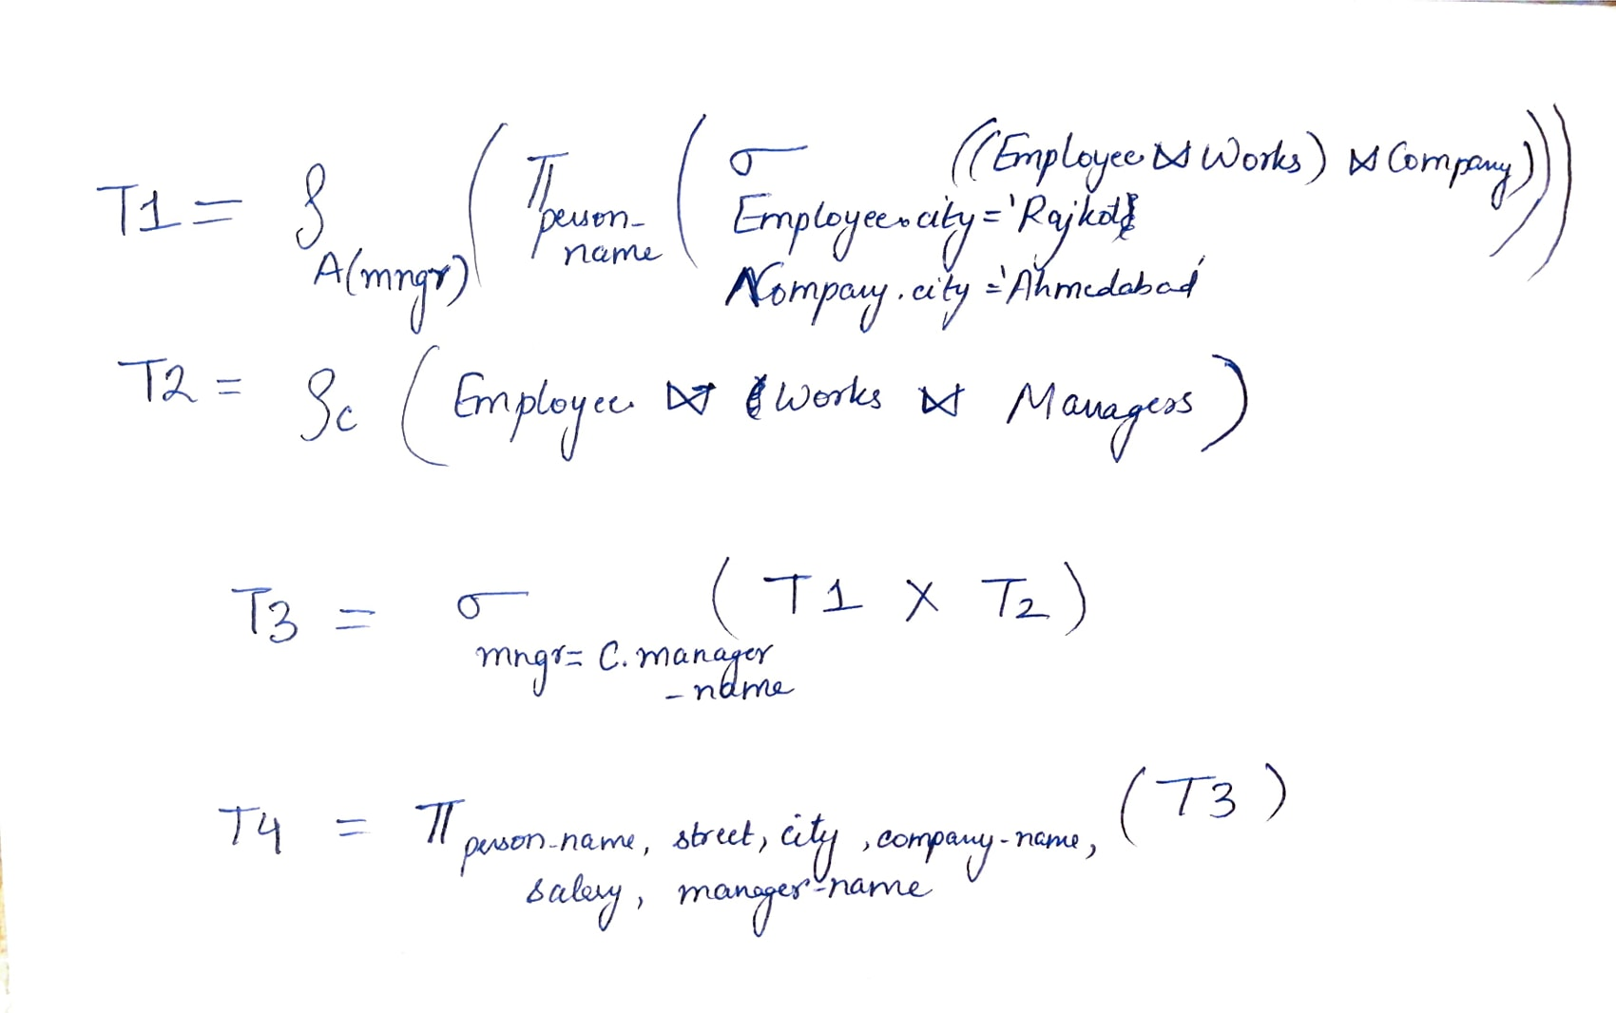
Display the name of employee with street, city, company name, salary and manager name staying in “Rajkot” and working in “Ahmedabad”.
Employee (person-name, street, city)
Works (person-name, company-name, salary)
Company (company-name, city)
Managers (person-name, manager-name)

Slide 76
Open Source and Commercial DBMS
Section - 4

Slide 77
Open Source and Commercial DBMS
Open Source | Commercial DBMS
DBMS, which is available in the market at free of cost. | DBMS, which is available in the market at a certain price.
The code of open source DBMS product can be viewed, shared or modified by the community. | The code of commercial DBMS product can not be view, share or modify by the community.
There are chances of malfunctioning with code as source code is open. | The security is high and code is not accessible to unauthorized person.
Examples: MySQL, MongoDB, SQLite etc | Examples: Microsoft SQL Server, IBM Db2 etc

Slide 78
Question Bank
Define Super key, Primary key, Candidate key and Alternate key.
Explain following Relational Algebra Operation with example.
Selection
Projection
Cross Product
Joins (Inner Join, Outer Joins)
Rename
Division
Set operators
Explain different aggregate functions with example.

Slide 79
Question Bank [Relational Algebra]
Consider the following relational database, where the primary keys are underlined. Give an expression in the relational algebra to express each of the following queries
employee (ssn, name, dno, salary, hobby, gender)
department (dno, dname, budget, location, mgrssn)
works_on (ssn, pno)
project (pno, pname, budget, location, goal)
List all pairs of employee names and the project numbers they work on.
List out department number, department name and department budget.
List all projects that Raj Yadav works on by project name.
List the names of employees who supervise themselves.

Slide 80
Question Bank [Relational Algebra]
Consider the following relational database, where the primary keys are underlined. Give an expression in the relational algebra to express each of the following queries
course (course-id, title, dept_name, credits)
instructor (id, name, dept_name, salary)
section (course-id, sec-id, semester, year, building, room_no, time_slot_id)
teaches (id, course-id, sec-id, semester, year)
Find the name of all instructors in the physics department.
Find all the courses taught in the fall 2009 semester but not in Spring semester.
Find the names of all instructors in the Comp. Sci. department together with the course titles of all the courses that the instructors teach.
Find the average salary in each department.

Slide 81
Question Bank [Relational Algebra]
Consider the following relations and write an relational algebra:
EMP (empno, ename, jobtitle, managerno, hiredate, sal, commission, deptno)
DEPT (deptno, dname, location)
Find the Employees working in the department number10, 20, 30 only.
Find Employees whose names start with letter A or letter a.
Find Employees along with their department name.
Find the Employees who are working in Smith's department
Find the Employees who get salary more than Allen’s salary.
Display employees who are getting maximum salary in each department.
Find list of employees whose hire date is on or before 1-April-18.

Slide 82
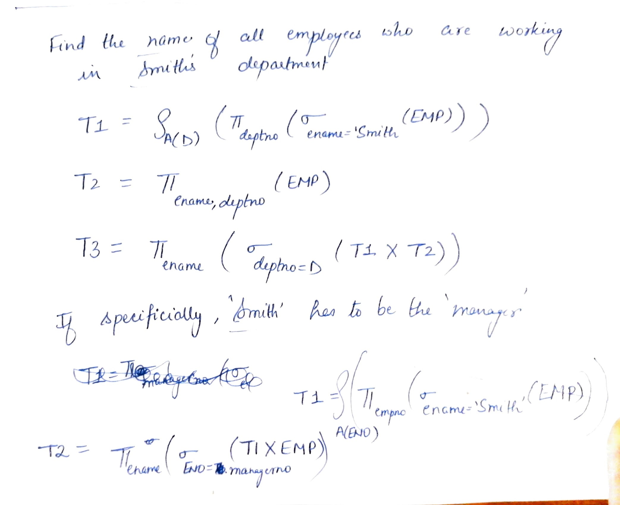
Find the Employees who are working in Smith's department
EMP (empno, ename, jobtitle, managerno, hiredate, sal, commission, deptno)
DEPT (deptno, dname, location)

Slide 83
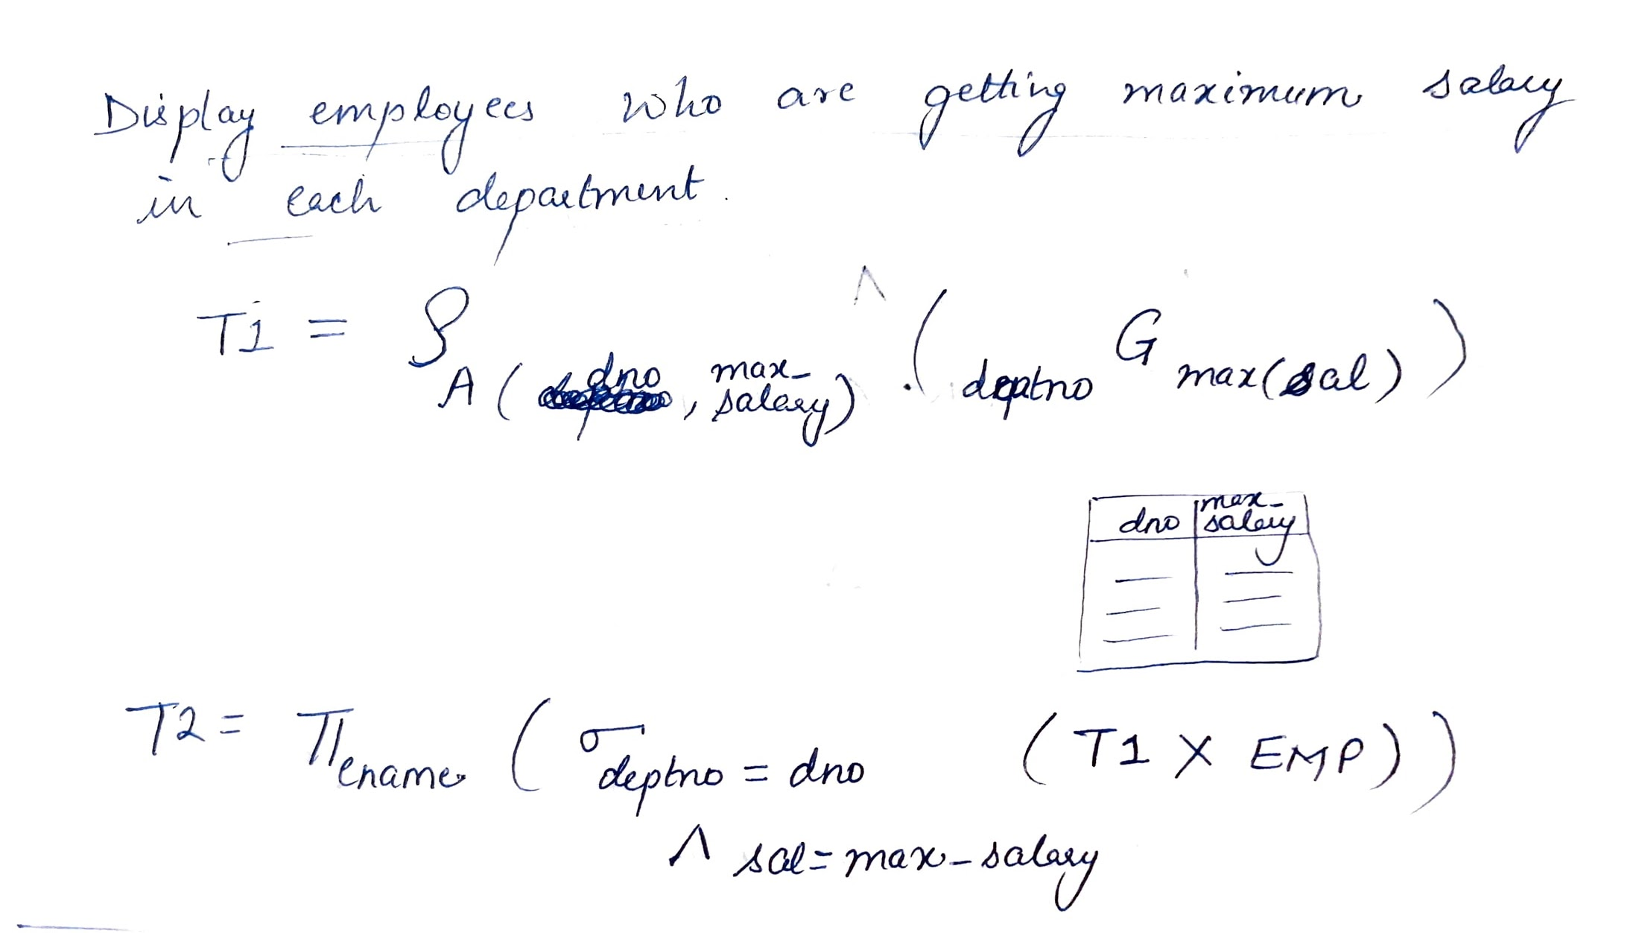
Display employees who are getting maximum salary in each department.
EMP (empno, ename, jobtitle, managerno, hiredate, sal, commission, deptno)
DEPT (deptno, dname, location)

Slide 84
Question Bank [Relational Algebra]
Consider the relational database given below and give an expression in the relational algebra:
Employee (person-name, street, city) ,
Works (person-name, company-name, salary)
Company (company-name, city) ,
Manages (person-name, manager-name)
Find the names of all employees in this database who live in the same city as the company for which they work.
Find the names, street address, and cities of residence of all employees who work for HCL and earn more than $10,000 per annum.

Slide 85
Question Bank [Relational Algebra]
The relational database schema is given below and write the relational algebra expressions for the given queries.
employee (person-name, street, city)
works (person-name, company-name, salary)
company (company-name, city)
manages (person-name, manager-name)
Find the names of all employees who work for First Bank Corporation.
Find the names and cities of residence of all employees who work for First Bank Corporation.
Find the names, street address, and cities of residence of all employees who work for First Bank Corporation and earn more than $10,000 per annum.
Find the names of all employees in this database who do not work for First Bank Corporation.

